Slide 1
Math and Statistics Support

Slide 2
Students and faculty need support!
Students lack prerequisite skills and study skills.
Teaching mathematics and statistics has become significantly harder for teachers.
We need to support our teachers so they can support the students.

Slide 3
WE need to change they way we teach Assume students are not prepared Adopt a support philosophy

Slide 4
Connected single topic “Just in time” support​
Teaching prerequisite class material separately is not effective.
Assess what skills your students are missing.
Provide the support students need for each transfer-level topic one at a time.

Slide 5
Connected single topic “Just in time” support
Connect Support Skills to Transfer-Level Skills
Repeat support skill training throughout the class.
Have a support philosophy in all math and statistics classes.
Regular classes need support also.

Slide 6
“just in time” statistics support Examples

Slide 7
Arithmetic Support skills
Calculating Proportions
Percentage/Proportion Conversions
Subtraction & Differences
Negative Numbers
Rounding
Comparing Decimals
Division & Quotient
Order of Operations
Number Line

Slide 8
Formula Support Skills
Analyzing and Evaluating Statistics Formulas
Standard Deviation $(S)= \sqrt{\frac{\sum{{\left(x−x̅\right)}^{2}}}{n−1}}$ = $\sqrt{\frac{Sum of Squares}{Degrees of Freedom}}= \sqrt{\frac{64.5}{17}}≈1.9 kg$
Matched Pair T-test statistic = $\frac{\left(\overline{d}−0\right)}{\left({s_{d}}/{\sqrt{n}}\right)}$ = $\frac{Mean Average of Differences}{Standard Error}$
$Variance Between= \frac{Sum of Squares Between}{Degrees of Freedom Between}$ = $\frac{\sum{{\left({x̅}_{i}−\overset{̿}{x}\right)}^{2}}}{k−1}$
$Variance Within= \frac{Sum of Squares Within}{Degrees of Freedom Within}$ = $\frac{\sum{{\left(x−{x̅}_{i}\right)}^{2}}}{(n−k)}$
F test statistic = $\frac{\left(\frac{Sum of Squares Between}{Degrees of Freedom Between}\right)}{\left(\frac{Sum of Squares Within}{Degrees of Freedom Within}\right)}$ = $\frac{Variance Between the Groups}{Variance Within the Groups}$

Slide 9
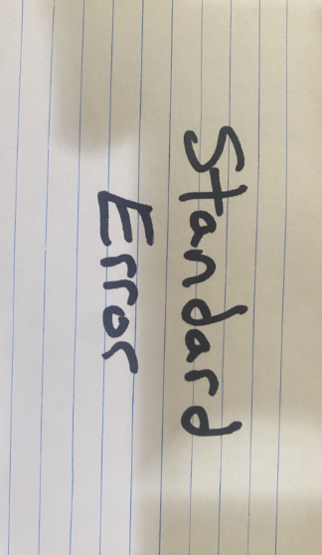
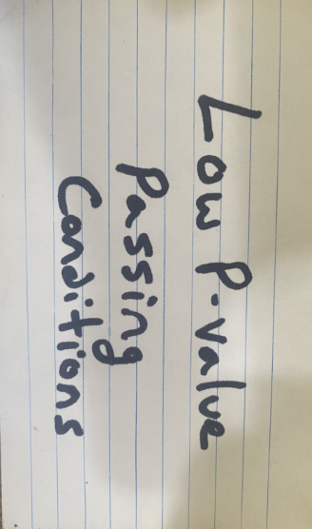
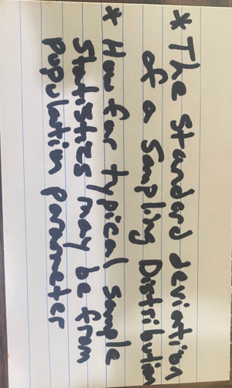
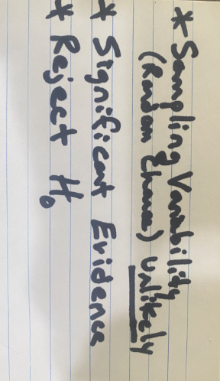
English Skills
3x5 cards for Vocabulary, Definitions, Theory, and Statistics Rules

Slide 10
English Skills
Sentence Writing
Standard Deviation Sentence:
Typical systolic blood pressures in our sample data could be as much as _______ mm of Hg from the sample mean average of _______ mm of Hg.
Two-Population Mean Average Confidence Interval Sentence
The mean average price of homes in California is between ________ and ________ thousand dollars (greater than or less than) the mean average price of homes in Arizona.
One-population T-test statistic sentence:
“The sample mean average weight ______ kg is ________ standard errors (above or below) the population mean average weight _______ kg in the null hypothesis.”

Slide 11
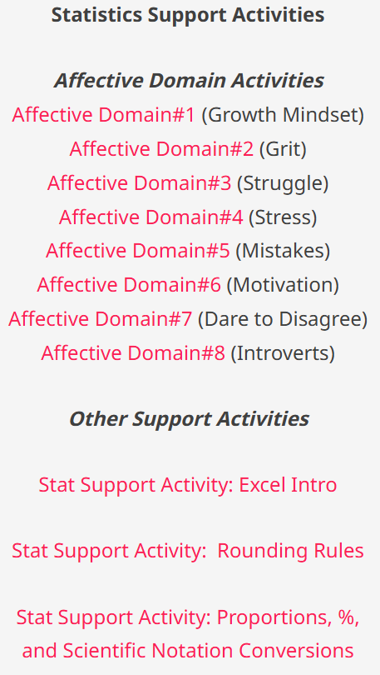
Affective Domain and other support activities
matt-teachout.org/pre-stats/

Slide 12
Practicing with Statkey (lock5stat.com)

Slide 13
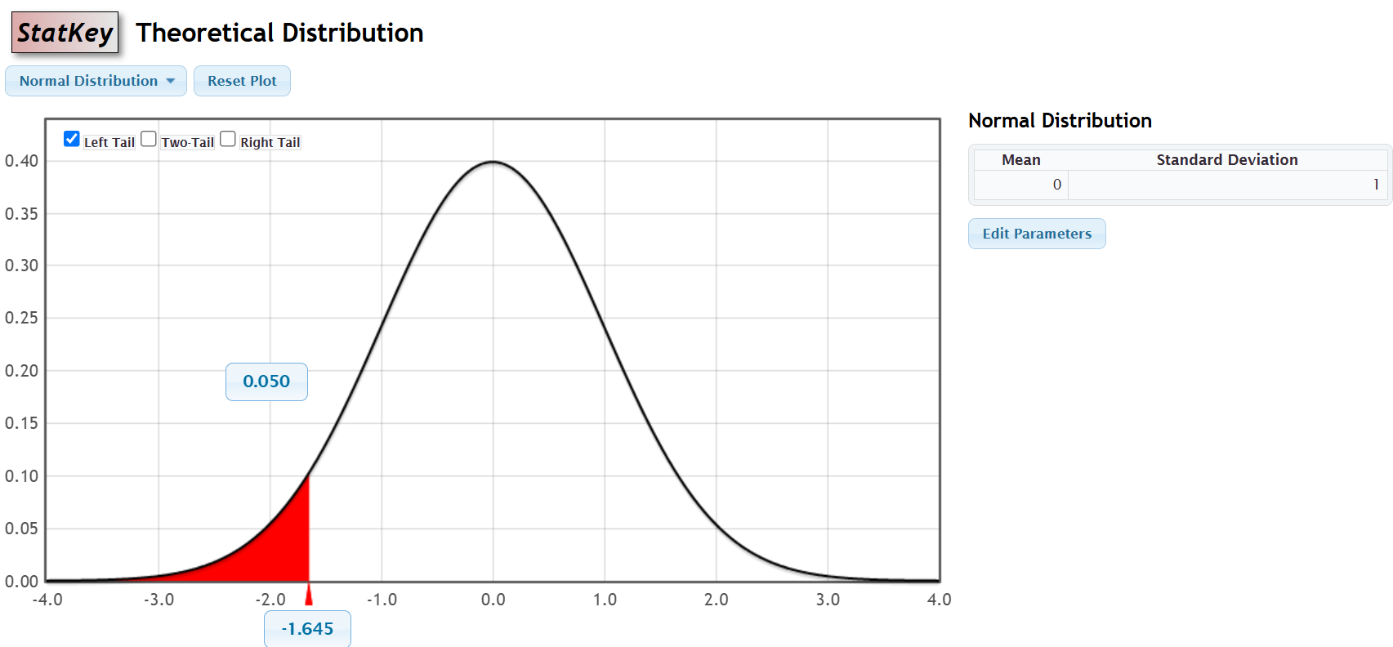
Practicing with Statkey (lock5stat.com)

Slide 14
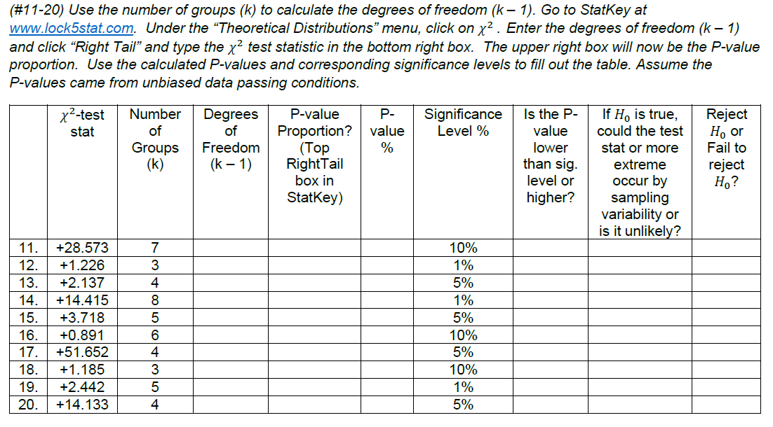
Practicing with Statkey (lock5stat.com)

Slide 15
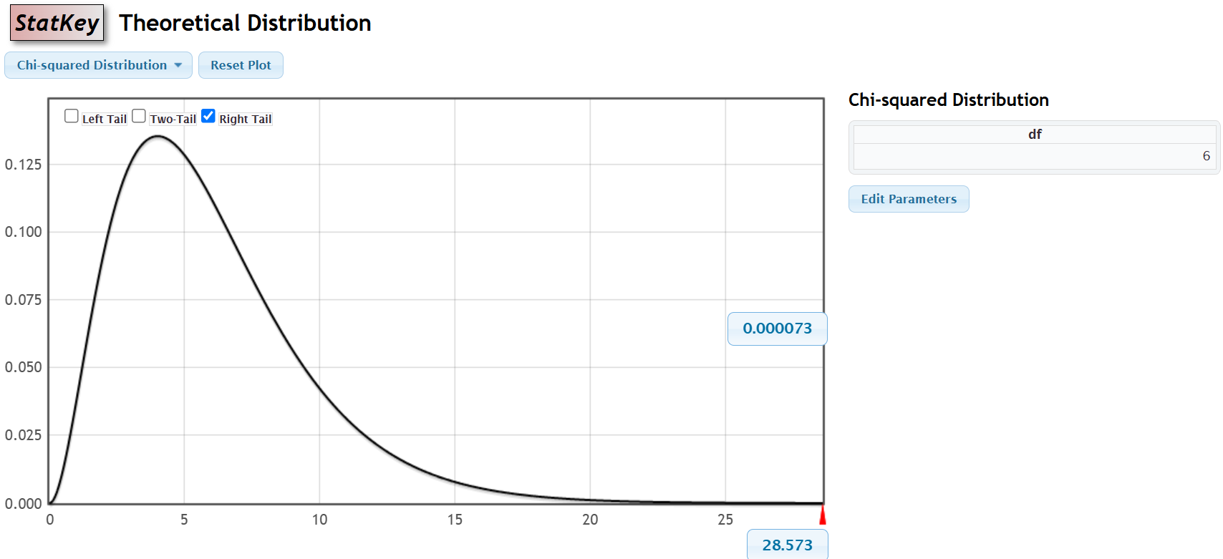
Practicing with Statkey (lock5stat.com)

Slide 16
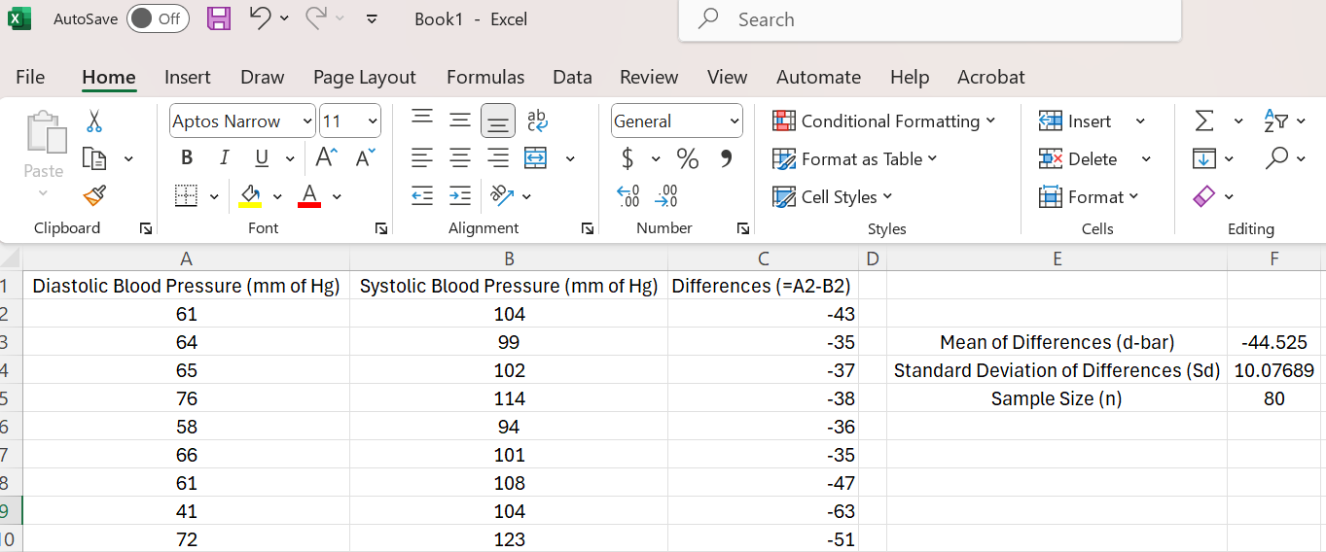
Practicing with excel

Slide 17
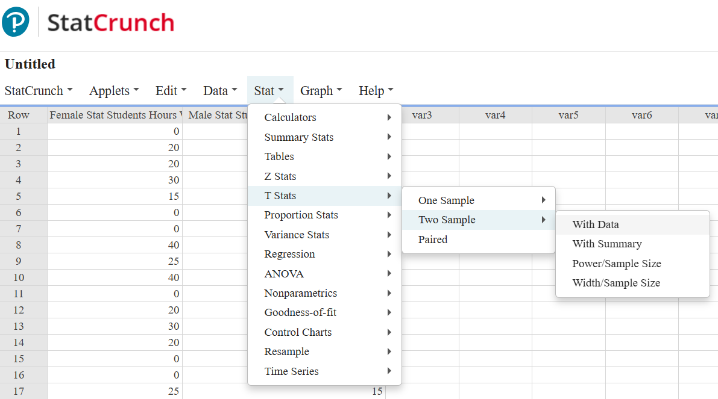
Practicing with STatCrunch (www.statcrunch.com)

Slide 18
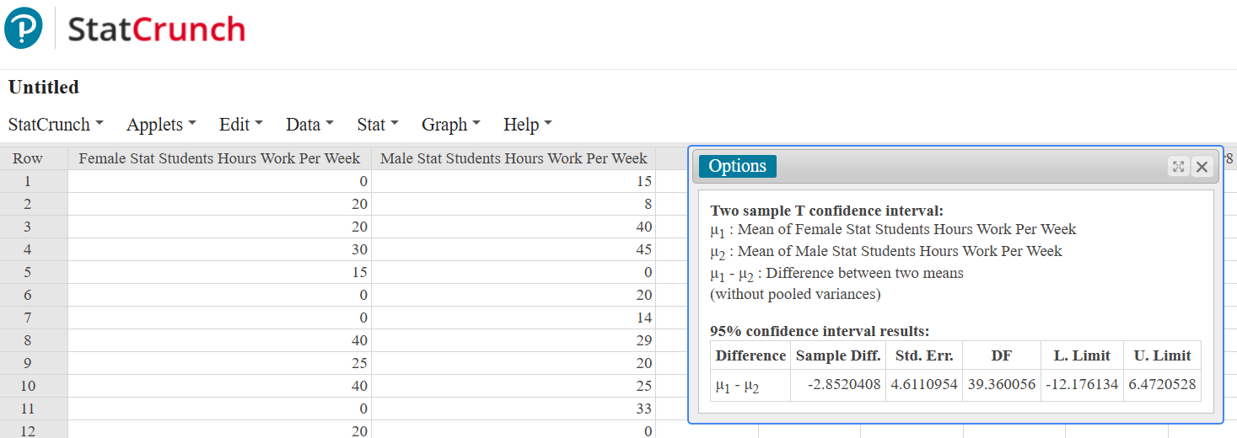
Practicing with STatCrunch (www.statcrunch.com)

Slide 19
Project Based assessment
Small Guided Projects on each unit or a Large Class Project broken into smaller parts.
Practical Experience for Data Analyst Jobs
Students more invested in the class material

Slide 20
Support Pedagogy
Avoid Large High Stakes Exams (Cheating, Giving Up)
Support Skills, Study Skills & Encouragement!
Significant Points for Working Hard
Projects, Quizzes, or Lower-Stakes Exams
“Mastery Learning” instead of a “Pass or Fail” mentality.​
Grading Scale
Four Projects (40%)
Quiz Average (20%)
Assignments (30%)
Final Exam (10%)

Slide 21
Discussion
Any Questions for Matt?
Discuss the following topics with the person or people sitting next to you. (If we run out of time, discuss them during lunch.)
Give a support topic that you teach in your math or stat class that helps students understand the transfer-level topic?
Teaching math has become increasingly difficult. What support and encouragement can we give our fellow teachers?
Do you think that the “just-in-time” support philosophy can apply to other math courses besides statistics? Explain how.

