Slide 1
Introduction to Statistics

Slide 2
Chapter 1: Collecting and Analyzing Data
Vocabulary
Data: Information in all forms. Statistics: The science of collecting, preparing and analyzing data.
Statistician: An expert in the science of statistics. The leaders in the field.
Data Mining: The process of collecting and storing data.
Data Science: Many feel this is just another word for statistics, but with maybe less emphasis on high-level statistical analysis and more emphasis on data mining and using computer science.
Data Scientist: A specialist in data science.
Data Analyst: A specialist in analyzing data to make good decisions.

Slide 3
StatKey
StatKey is hosted online at www.lock5stat.com

Slide 4
Chapter 1: Collecting and Analyzing Data
Vocabulary
Data: Information in all forms.
Population: The collection of all people or objects to be studied.
Census: Collecting data from everyone in a population.
Sample: Collecting data from a small subgroup of the population.
Bias: When data does not represent the population.

Slide 5
Section 1A – Two Types of Data – Categorical and Quantitative
Categorical Data:
Categorical data (or qualitative data) are generally labels that tell us something about the people or objects in the data set. For example, what country do they live in, what is the person’s occupation, or what kind of pet they have?
Usually categorical data is made up of words (do you smoke - yes or no), but occasionally a number can be used as a category. For example, a zip code can be used instead of the place a person lives. The numbers “1” and “2” may be used instead of yes and no.

Slide 6
Quantitative Data
Quantitative data are numbers that measure or count something.
They usually have units and taking an average makes sense.
We can find the average height, the average weight, or the average number of dogs in animal shelters in Los Angeles.

Slide 7
Section 1B – Collecting Data
Population: The collection of all people or objects you want to study.
Census: Collecting data from everyone in the population.
Sample: Collecting data from a small subgroup of the population.
Bias: When data does not reflect the population.
Random: When everyone in the population has a chance to be included in the sample.

Slide 8
Method 1: Census
A census is the best way to collect data if it is possible. If our goal is to learn about the population, it makes sense to collect data from everyone in the population. There are ways for a census to be biased, but in terms of the collecting method, a census is the best. Unfortunately, it is almost impossible to collect a census if your population is large. Most statisticians and data scientists are only able to collect a sample, data collected from a small subgroup of the population.

Slide 9
Method 2: Simple Random Sample
If a statistician or data scientist cannot collect a census, the preferred method is to collect a random sample. A random sample is one where everyone in the population has a chance to be in the sample, so it tends to represent the population better than other non-random samples. It is nowhere near as good as a census, but as I said, a census is usually not possible. A simple random sample is one where individuals in the population are selected randomly

Slide 10
Method 3: Convenience Sample
People often find collecting a census or a simple random sample difficult, so they chose to collect data in whatever way seems easiest. A sample collected this way is often called a “convenience sample” and is popular with people not trained in statistics. A convenience sample usually has much more bias than a random sample and may not represent the .population very well

Slide 11
Method 4: Voluntary Response Sample
A voluntary response sample puts a survey out into the world and allow anyone to respond. The usual method used today is to put a survey on a website and allow anyone that comes across the survey to answer. The survey can also be a mailed to every address in a given population

Slide 12
Method 5: Cluster Sample
A cluster sample is one where data is collected from groups of people in a population instead of one at a time.

Slide 13
Method 6: Stratified Sample
One of the most common studies done in statistics is to compare groups. We may compare data from 2016 to data from this year. We may compare people living in Canada to people living in Australia. To compare groups, you need to collect a stratified sample.

Slide 14
Method 7: Systematic Sample
A systematic sample is one where we use a system to collect the sample. Usually it involves collecting data from every fifth person that comes in your store or every twentieth person on a list.

Slide 15
Section 1C – Bias
Definition:
Population: The collection of all people or objects you want to study.
Bias: When data does not reflect the population.

Slide 16
1. Sampling Bias
Ex: Convenience Sample.
Ex: Voluntary Response Sample.

Slide 17
2.Question Bias
A question bias occurs when someone phrases a question in a specific way to force people to answer the way they want.

Slide 18
3.Response Bias
People are likely to lie or given an inaccurate response. When dealing with topics that people are likely to lie about, the data scientist needs to have a plan to deal with the response bias. Instead of asking people their weights, maybe they weigh them on a scale. Instead of asking people about their salary, maybe they look at paycheck stubs. Instead of asking people about substance abuse, they may collect data from agencies that support people with addiction.

Slide 19
4. Non-response Bias
Non-response bias is becoming a huge problem for all people that collect data. None-Response Bias is not= Voluntary Response Sample.
When people refuse to answer or give data.

Slide 20
5. Deliberate Bias
Deliberate bias can take on a variety of forms. It could be someone deliberately leaving out groups from the data. Deliberate bias is a major problem in statistics. It is also a good reason to have an independent statistics company collect the data and do the analysis

Slide 21
Section 1D – Experimental Design
Defenition:
Explanatory Variable: The independent or treatment variable. In an experiment, this is the variable causes the effect.
Response Variable: The dependent variable. In an experiment this the variable that measures the effect.
Confounding Variables (or lurking variables): Other variables that might influence the response variable other than the explanatory variable being studied.

Slide 22
Random assignment: A process for creating similar groups where you take a group of people or objects and randomly split them into two or more groups.
Placebo Effect: The capacity of the human brain to manifest physical responses based on the person believing something is true.
Placebo: A fake medicine or fake treatment used to control the placebo effect.

Slide 23

Section 1E – Categorical Data Analysis
Proportion and Percentage Conversions
Calculating Proportions and Percentages from Categorical Data In order to calculate a decimal proportion from categorical data, you will need to find the amount (count, frequency) and divide by the total. Decimal Proportion
=$\frac{Amount(frequncy)}{Total}$
Suppose a health clinic has seen 326 people in the last month and 41 of them had the flu. If we were analyzing their data, the first thing we would like to do is find what proportion of the patients have the flu. It is not a difficult calculation and can be done with a small calculator.
Proportions are usually rounded to the thousandths place (3rd place to the right of the decimal).

Slide 24
Bar Charts and Pie Charts
A quick way to count how many people or objects have a certain label is to create a Bar Chart or Pie Chart. There are many different statistics software that we could use to create these graphs. They are useful to show the characteristics of categorical data.
Creating a Bar Ch chart with Raw Data and StatKey.
To make a bar chart with raw data, go to www.lock5stat.com

Slide 25

Comparing Percentages
Percent of Increase =$\frac{(higher proportion −lower proportion)}{lower proportion}×100\%$
Percent of Increase=$\frac{(higher\%−lower\%}{lower\%}×100\%$

Slide 26
Section 1F – Normal Quantitative Data Analysis
Vocabulary
Quantitative data: Data in the form of numbers that measure or count something. They usually have units and taking
an average makes sense. For example, height, weight, salary, or the number of pets a person has.
Normal Data: Data that is bell shaped, symmetric and unimodal. Also referred to as data that has a normal
distribution.
Sample Size: Also called the total frequency.
Average: Also called the center of the data. A single number that represents a typical person or object in the
data set.
Variability: Also called the spread. A measure of how spread out a data set is. A large spread tells us that the data
is less consistent and the more difficult to predict. A small spread tells us that the data is more consistent and easier
to predict.
Mean Average : The balancing point for distances in a data set. The average for a data set that is normal.
Standard Deviation: The average or typical distance that points in a data set are from the mean. The measure of
typical spread (typical variability) for a data set that is normal.
Maximum: The largest number in a data set.
Minimum: The smallest number in a data set.
Outliers: Unusual values in the data set.
Introduction

Slide 27


Mean and Standard Deviation

Slide 28
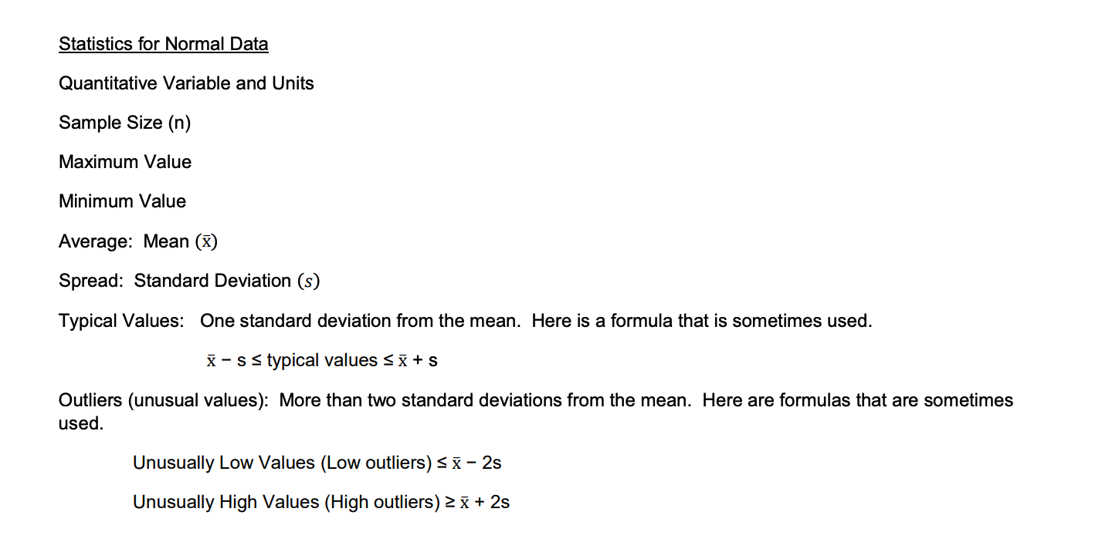

Slide 29
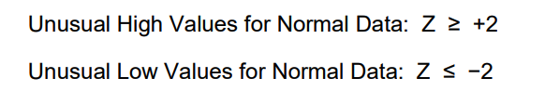
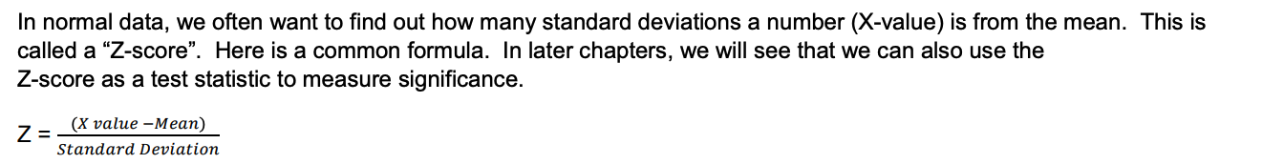
Z-scores

Slide 30
Empirical Rule

Slide 31
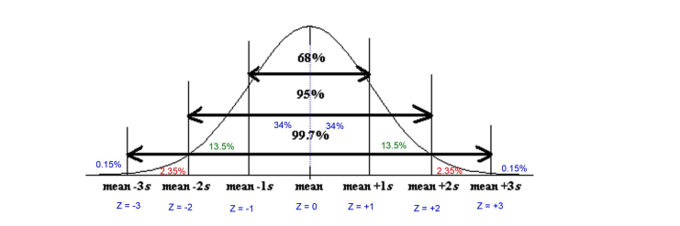

Slide 32
Section 1G – Quantitative Data Analysis for Non-Normal Data and Summary Statistics
Vocabulary
Quantitative data: Data in the form of numbers that measure or count something. They usually have units and taking an average makes sense. For example, height, weight, salary, or the number of pets a person has.
Normal Data: Data that is bell shaped, symmetric and unimodal.
Skewed Right Data: Also called positively skewed. Data where the center is on the far left and has a long tail to the right.
Skewed Left Data: Also called negatively skewed. Data where the center is on the far right and has a long tail to the left.
Sample Size: Also called the total frequency. The number of values are in a data set. Median Average: The center of the data when the numbers are put in order. Also called the “50th Percentile” (𝑃50). Since about 50% of the numbers in the data set are less than the median. It is also called the “Second Quartile” (𝑄2). The average for a data set that is not normal.

Slide 33
First Quartile (𝑄1): The number that about 25% of the data values are less than. Used for typical values for data that is not normal.
Third Quartile (𝑄3): The number that about 75% of the data values are less than. Used for typical values for data that is not normal.
Interquartile Range (IQR): The distance between the middle 50% of the numbers in a data set. Calculated by subtracting the 1st and 3rd quartiles. The measure of typical spread for a data set that is not normal.
Maximum: The largest number in a data set.
Minimum: The smallest number in a data set. Range: A quick measure of total spread. Calculated by subtracting the minimum and maximum values in a data set.
Outliers: Unusual values in the data set.

Slide 34
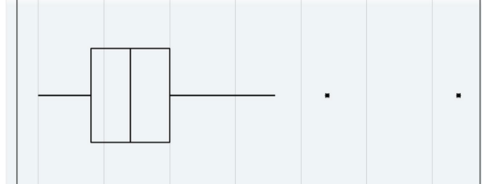
A box plot is a graph of the first quartile, median, third quartile and outliers.
It is the perfect graph to look at when a data set is not normal.
The left of the box is 𝑄1 and far right of the box is 𝑄3.
So the box represents the typical values (middle 50%). The line inside the box is the median average.
The lines that go to the left and right of the box are called whiskers.
The whiskers go to the lowest and highest numbers in the data set that are not unusual (not outliers).

Slide 35
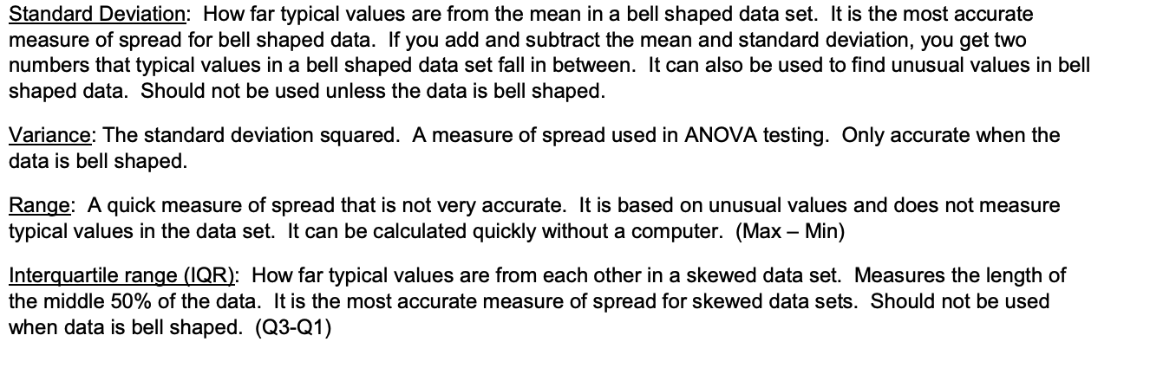
Measures of Spread

Slide 36
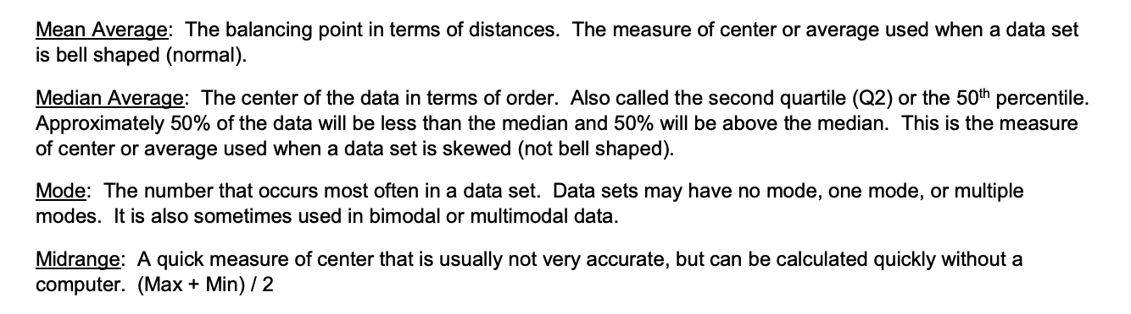
Measures of Center

Slide 37
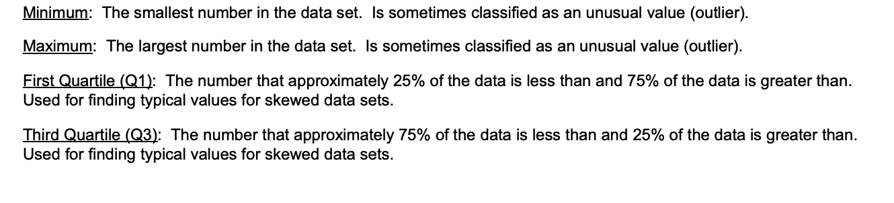
Measures of Position

Slide 38
Frequency or Sample Size (n)
The frequency or sample size of a data set (n) is not a measure of center, spread or position, but is important bit of information. It tells us how many numbers are in the data set.

