Slide 1
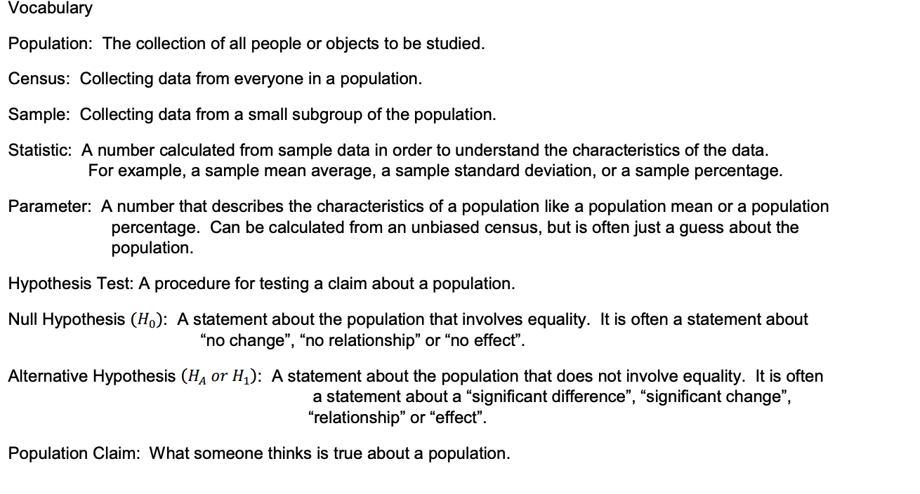
Chapter 3: Introduction to Hypothesis Testing
Section 3A – Null and Alternative Hypothesis

Slide 2
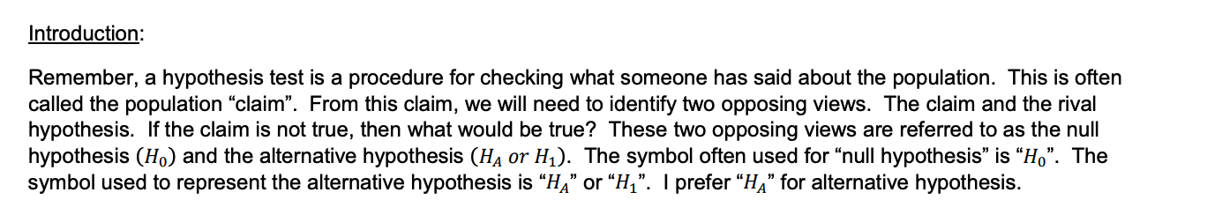
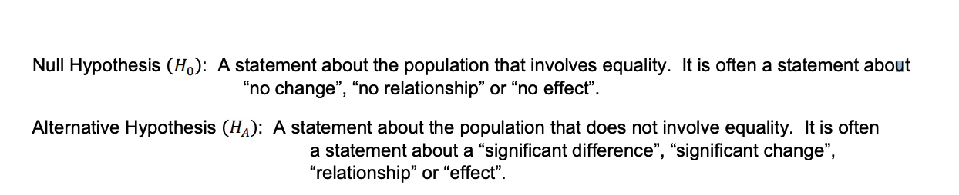

Slide 3
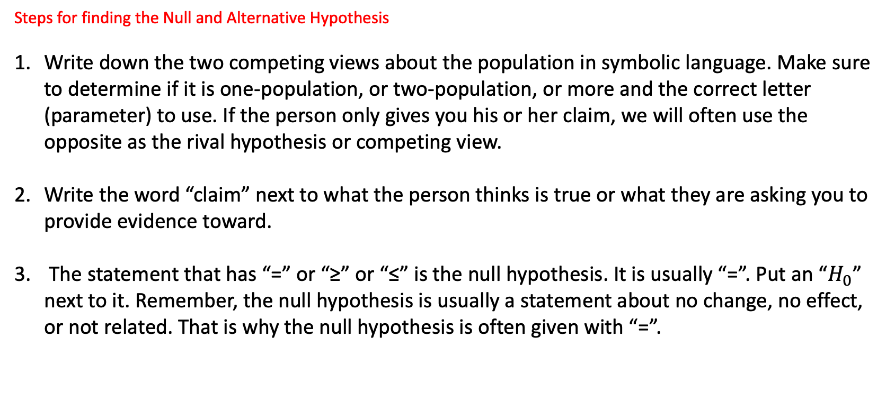
Steps for finding the Null and Alternative Hypothesis
Write down the two competing views about the population in symbolic language. Make sure to determine if it is one-population, or two-population, or more and the correct letter (parameter) to use. If the person only gives you his or her claim, we will often use the opposite as the rival hypothesis or competing view.
Write the word “claim” next to what the person thinks is true or what they are asking you to provide evidence toward.
The statement that has “=” or “≥” or “≤” is the null hypothesis. It is usually “=”. Put an “$H_{0}$” next to it. Remember, the null hypothesis is usually a statement about no change, no effect, or not related. That is why the null hypothesis is often given with “=”.

Slide 4

4 The statement that has “≠” or “” is the alternative hypothesis. Put an “$H_{A}$” next to it. This is usually a statement about something changing or being related or having a significant effect.
5. Determine what type of test you are dealing with. Is it right-tailed, left-tailed or two-tailed? In a hypothesis test, we are often attempting to “reject the null hypothesis”. This would happen if we believed the alternative hypothesis is correct. For this reason, the alternative hypothesis determines what type of test you are doing. In a one-population or two-population test, if $H_{A}$ is less than (<), it is a left tailed test. If $H_{A}$ is greater than(>) it is a right tailed test. If $H$ is not equal (≠), it is a two-tailed test.

Slide 5
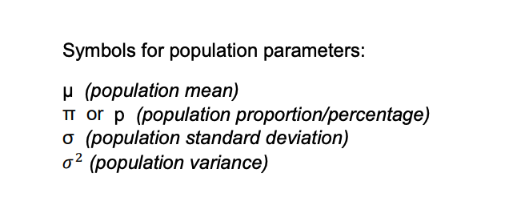

Slide 6
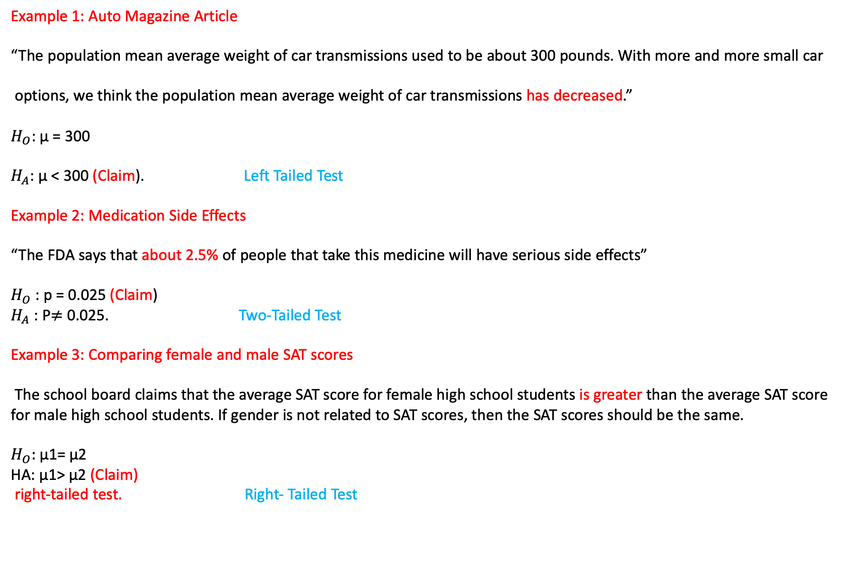
Example 1: Auto Magazine Article
“The population mean average weight of car transmissions used to be about 300 pounds. With more and more small car
options, we think the population mean average weight of car transmissions has decreased.”
$H_{O}$: µ = 300
$H_{A}$: µ < 300 (Claim). Left Tailed Test
Example 2: Medication Side Effects
“The FDA says that about 2.5% of people that take this medicine will have serious side effects”
$H_{O}$: p = 0.025 (Claim)
$H_{A}$: P$≠$ 0.025. Two-Tailed Test
Example 3: Comparing female and male SAT scores
The school board claims that the average SAT score for female high school students is greater than the average SAT score for male high school students. If gender is not related to SAT scores, then the SAT scores should be the same.
$H_{O}:$ µ1= µ2
HA: µ1> µ2 (Claim)
right-tailed test. Right- Tailed Test

Slide 7
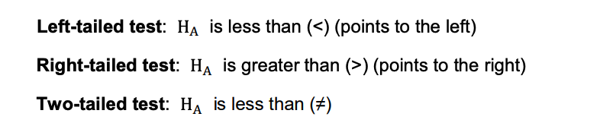
Three Types of Hypothesis Tests

Slide 8
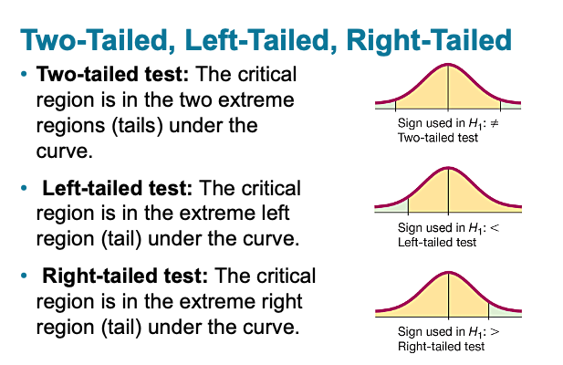

Slide 9
Section 3B – Test Statistics and Critical Values
Hypothesis Test: A procedure for testing a claim about a population.
Null Hypothesis (𝐻0): A statement about the population that involves equality. It is often a statement about “no change”, “no relationship” or “no effect”.
Test Statistic: A number calculated in order to determine if the sample data significantly disagrees with the null hypothesis. There are a variety of different test statistics depending on the type of data.
Critical Value: We compare a test statistic to this number to determine if the sample data significantly disagrees with the null hypothesis.

Slide 10
When we start to run a Hypothesis Test, our random sample data is almost always going disagree with the null Hypothesis, even the null hypothesis is absolutely correct.
Test Statistic: A number calculated in order to determine if the sample data significantly disagrees with the null hypothesis.
Using Test Statistics and Critical Values to Judge Significance
Key question: How can we tell if the test statistic indicates a significant disagreement between the sample data and the null hypothesis? The answer to this is to compare the test statistic to a critical value.
Critical Value: We compare a test statistic to this number to determine if the sample data significantly disagrees with the null hypothesis. Critical values and test statistics are always different depending on the situation.

Slide 11
Significance Rule for Test Statistics and Critical Values
• If the test statistic falls in the tail determined by the critical value (or values), then the sample data significantly disagrees with the null hypothesis.
• If the test statistic does NOT fall in the tail determined by the critical value (or values), then the sample data does NOT significantly disagree with the null hypothesis.

Slide 12
Significance Levels (Alpha Levels) (𝛼)-The significance level (or alpha level) is an important number in a hypothesis test.
Confidence Levels (1 − 𝛼) Significance levels(𝛼)
90% (0.90) 10% (0.10)
95% (0.95 ) 5% (0.05
99% (.99) 1% (0.01)
If you want to be 95% confident, you will use a 5% significance level in your hypothesis test. Similarly, if you want to be 90% confident, you will use a 10% significance level. 99% confident corresponds to a 1% significance level.

Slide 13
Section 3C – P-value and Significance Levels
P-value:
The probability of getting the sample data or more extreme because of sampling variability (by random chance) if the null hypothesis is true.
If the P-value is close to zero (lower than the significance level) then it is unlikely to be sampling variability (random chance).
P-value close to zero → Unlikely to be sampling variability → Reject 𝐻0

Slide 14
If the P-value is higher than the significance level, then the sample data could have occurred because of sampling variability.
P-value higher than the significance level → Could be sampling variability → Fail to reject 𝐻0.

Slide 15
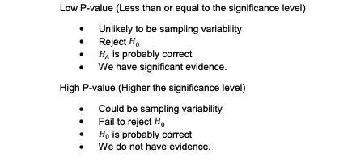

Slide 16
Section 3D – Conclusions

Slide 17
Notice there are 4 Possible Conclusions.
If the claim is 𝐻0 , P-value from good data is low (Think “Yes Evidence Reject”)
Conclusion Sentence: There is significant evidence to reject the claim.
If the claim is 𝐻0 , P-value is high or data is bad (Think “No Evidence Reject”)
Conclusion Sentence: There is not significant evidence to reject the claim.
If the claim is 𝐻𝐴 , P-value from good data is low (Think “Yes Evidence Support”)
Conclusion Sentence: There is significant evidence to support the claim.
If the claim is 𝐻𝐴 , P-value is high or data is bad (Think “No Evidence Support”)
Conclusion Sentence: There is not significant evidence to support the claim. tell if the claim is correct.)

Slide 18
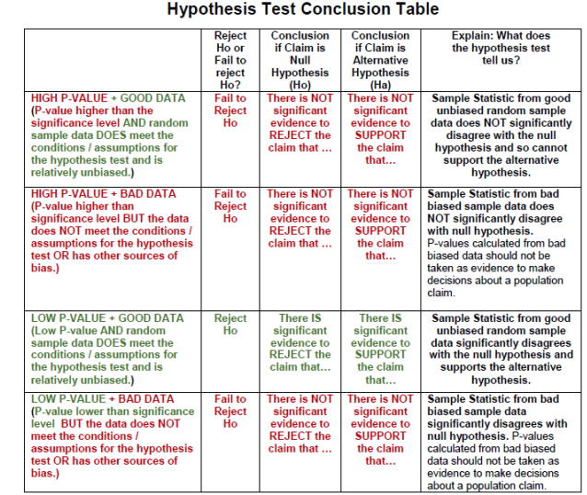

Slide 19
Section 3E – Type 1 and Type 2 Errors

Slide 20
Type 1 Error: When biased sample data leads you to support the alternative hypothesis when the alternative hypothesis is actually wrong in the population.
Type 2 Error: When biased sample data leads you fail to reject the null hypothesis when the null hypothesis is actually wrong in the population.

Slide 21
Type 1 Error Summary( False Positive)
• Biased random sample data leads to a low P-value.
• We support the alternative hypothesis when in the population the alternative hypothesis is wrong.
• The probability of a type 1 error is the significance level or alpha level (𝛼)
• To decrease the probability of a type 1 error, decrease the significance level (decrease α).
Example:
H₀: The medicine has no effect.
You conclude the medicine works (reject H₀), but in reality, it doesn’t.
Type 2 Error Summary (False Negative)
• Biased random sample data leads to a high P-value.
• We fail to reject the null hypothesis when in the population the null hypothesis is wrong.
• The probability of a type 2 error is called the beta level (𝛽𝛽).
• To decrease the probability of a type 2 error, increase the sample size. Collect more data.
Example:
H₀: The medicine has no effect.
You conclude it doesn’t work (fail to reject H₀), but in reality, it does.

Slide 22
1. Alpha (α) – Significance Level
Definition: α is the probability of making a Type I error.
Type I error: Rejecting the null hypothesis (H₀) when it is actually true.
How it’s used:
  When you set up a hypothesis test, you choose a significance level α (common values: 0.05, 0.01).
  It’s the threshold for deciding whether your result is “statistically significant.”
Example:
α = 0.05 → You are willing to accept a 5% chance of falsely claiming an effect exists when it doesn’t.
If your p-value ≤ α, you reject H₀

Slide 23

2. Beta (β) – Probability of Type II Error
Definition: β is the probability of making a Type II error.
Type II error: Failing to reject H₀ when the alternative hypothesis (H₁) is actually true.
Power of a test:
$\text{Power}=1−β$
  Power is the probability of correctly detecting a true effect.
  Higher power → less chance of missing a real effect.
Example:
β = 0.20 → There is a 20% chance you will fail to detect an effect that really exists.
Then, power = 1 – 0.20 = 0.80 → 80% chance of correctly detecting the effect.

Slide 24
Section 3F – One-population Mean and Proportion Hypothesis Tests

Slide 25
One-population Mean Assumptions
• The quantitative sample data should be collected randomly or be representative of the population.
• Data values within the sample should be independent of each other.
• The sample size should be at least 30 or have a nearly normal shape.
One-population Proportion Assumptions
• The categorical sample data should be collected randomly or be representative of the population.
• Data values within the sample should be independent of each other.
• There should be at least ten successes and at least ten failures.

Slide 26
1.Write the null and alternative hypothesis. Write down the population claim and the null and alternative hypothesis. Consider the type of data you will need and the number of populations to decide the appropriate test for the situation. Is this a right tailed, left tailed or two tailed test? What test statistic should we use? Consider the type 1 and type 2 errors and pick a significance level.
2. Collect random sample data and check the assumptions. If the sample data has not been collected yet, collect random sample data that is appropriate. Once the sample data is collected, check the assumptions to make sure the data represents the population and can be used for the hypothesis test. You may need to create a histogram to check normality. If certain assumptions are not met, consider revising your hypothesis test method. You may need to move to a non-parametric test or use a randomization technique.
3.. Use computer technology to calculate the test statistic, critical value, and P-value and use them to interpret significance and sampling variability. Compare the test statistic to the critical value. If the test statistic falls in the tail, then the sample data significantly disagrees with the null hypothesis. Compare the P-value to your chosen significance level. If the P-value is less than the significance level, then it is unlikely to be sampling variability.
Steps to perform a Hypothesis Test

Slide 27
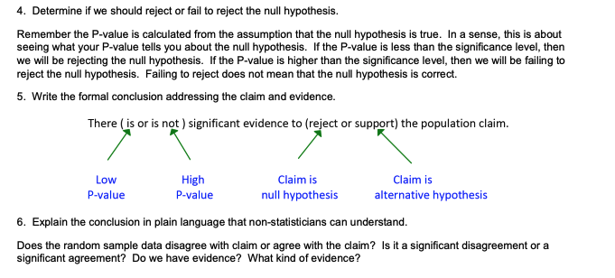
Steps to perform a Hypothesis Test

